Slide 1
Create Map-Based Apps

Slide 2
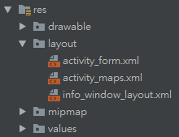
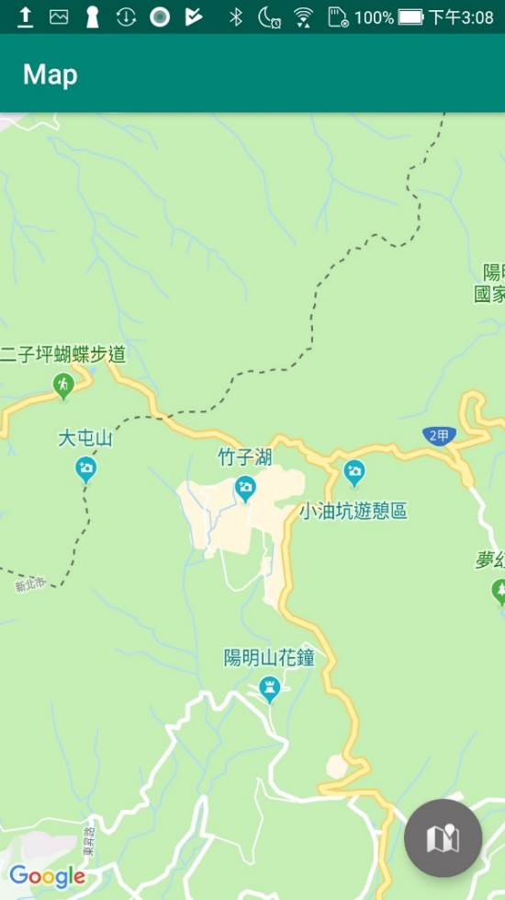
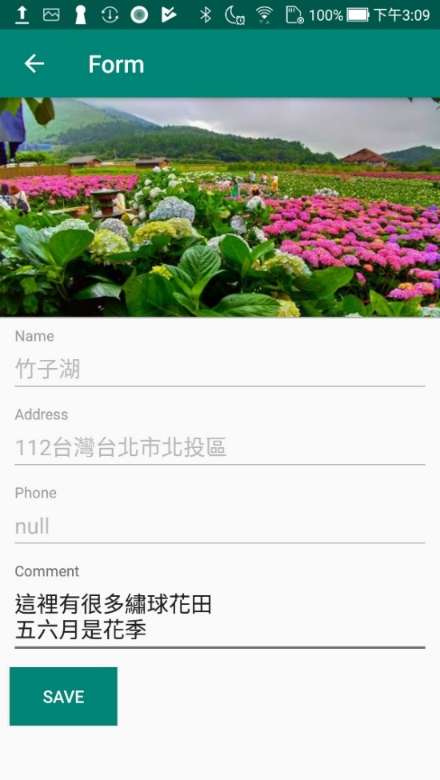
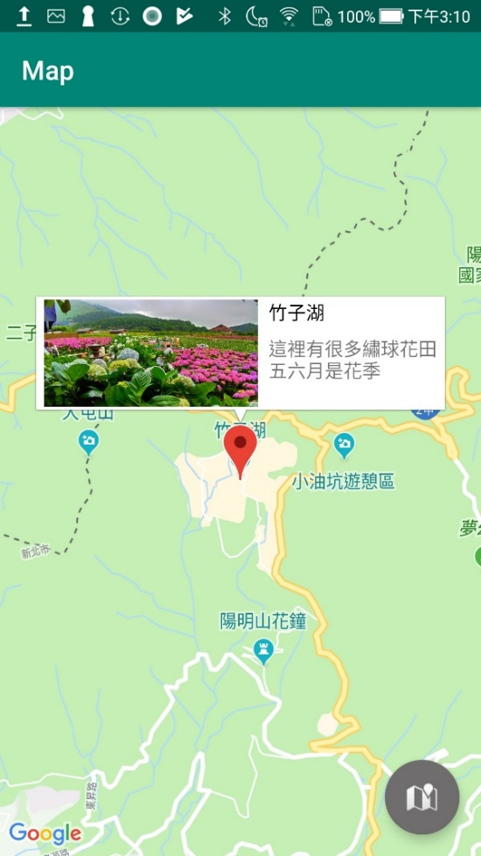
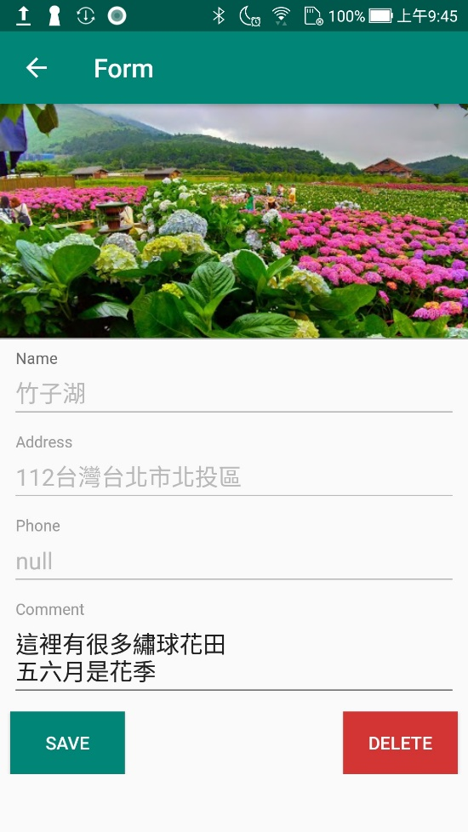
Notes:
點擊POI後切換到表單，新增資料後回到地圖並畫上marker
點擊marker後會彈出infowindow
點擊infowindow後切換到表單，修改或刪除資料後回到地圖並更新marker

Slide 3
Get a Google maps API key
Steps:
Generate a keystore (optional)
Get SHA-1 Fingerprint
Create Google API project
Add certification
Get API key
Enable Maps SDK for Android
Set API key in Android project
Notes:
https://docs.microsoft.com/zh-tw/xamarin/android/platform/maps-and-location/maps/obtaining-a-google-maps-api-key?tabs=windows

Slide 4
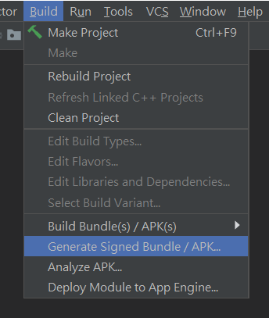
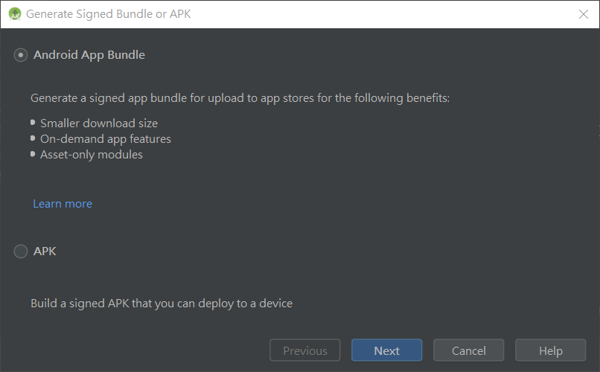
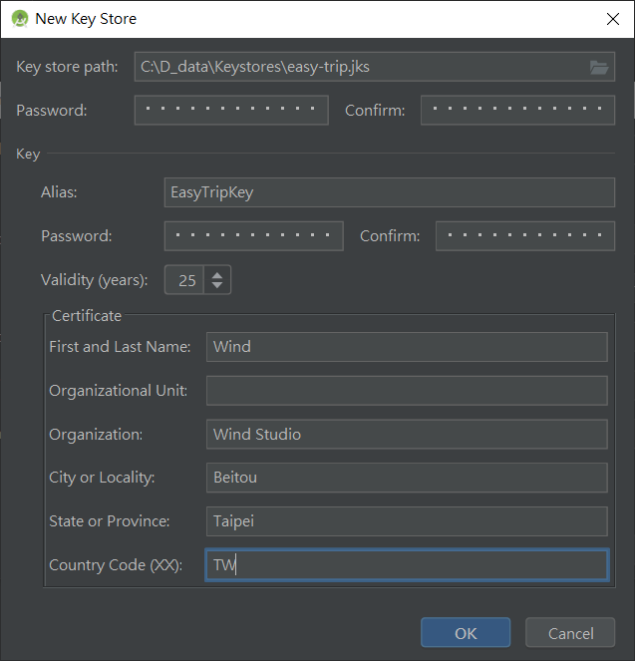
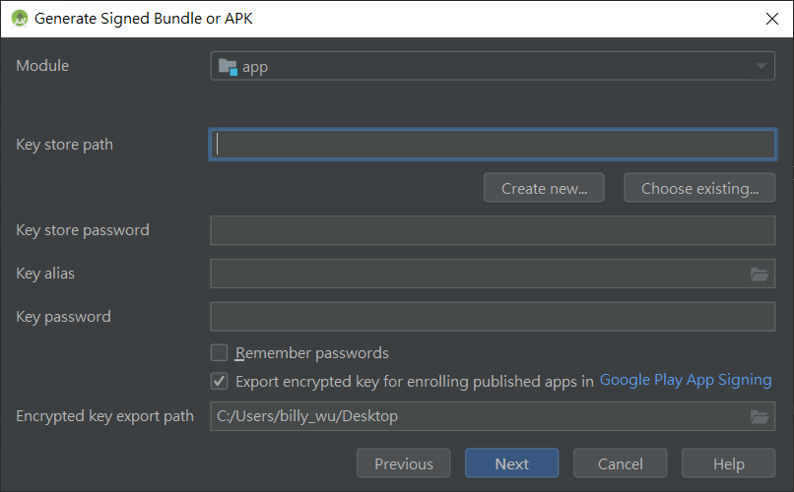
1. Generate a keystore (optional)
Notes:
https://docs.microsoft.com/zh-tw/xamarin/android/platform/maps-and-location/maps/obtaining-a-google-maps-api-key?tabs=windows

Slide 5
2. Get SHA-1 Fingerprint (1/3)
keytool
path (windows) → C:\Program Files\Java\jdk1.8.0_221\bin
Add this path to environment variable
Open cmd.exe & execute this command
keytool -list -v -keystore "%USERPROFILE%\.android\debug.keystore" -alias androiddebugkey -storepass android -keypass android
Change keystore for release mode
Notes:
https://docs.microsoft.com/zh-tw/xamarin/android/platform/maps-and-location/maps/obtaining-a-google-maps-api-key?tabs=windows

Slide 6
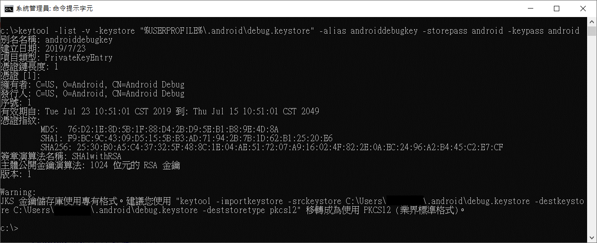
2. Get SHA-1 Fingerprint (2/3)

Slide 7
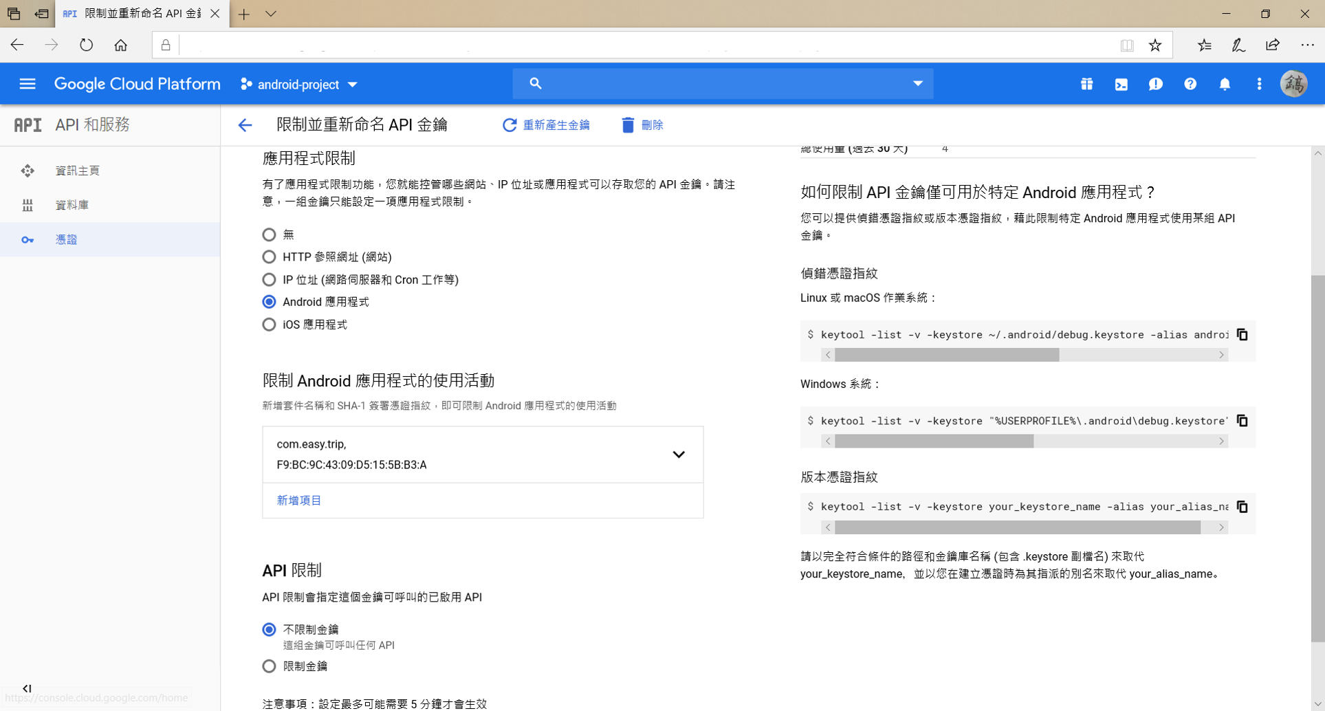
2. Get SHA-1 Fingerprint (3/3)
Notes:
https://docs.microsoft.com/zh-tw/xamarin/android/platform/maps-and-location/maps/obtaining-a-google-maps-api-key?tabs=windows

Slide 8
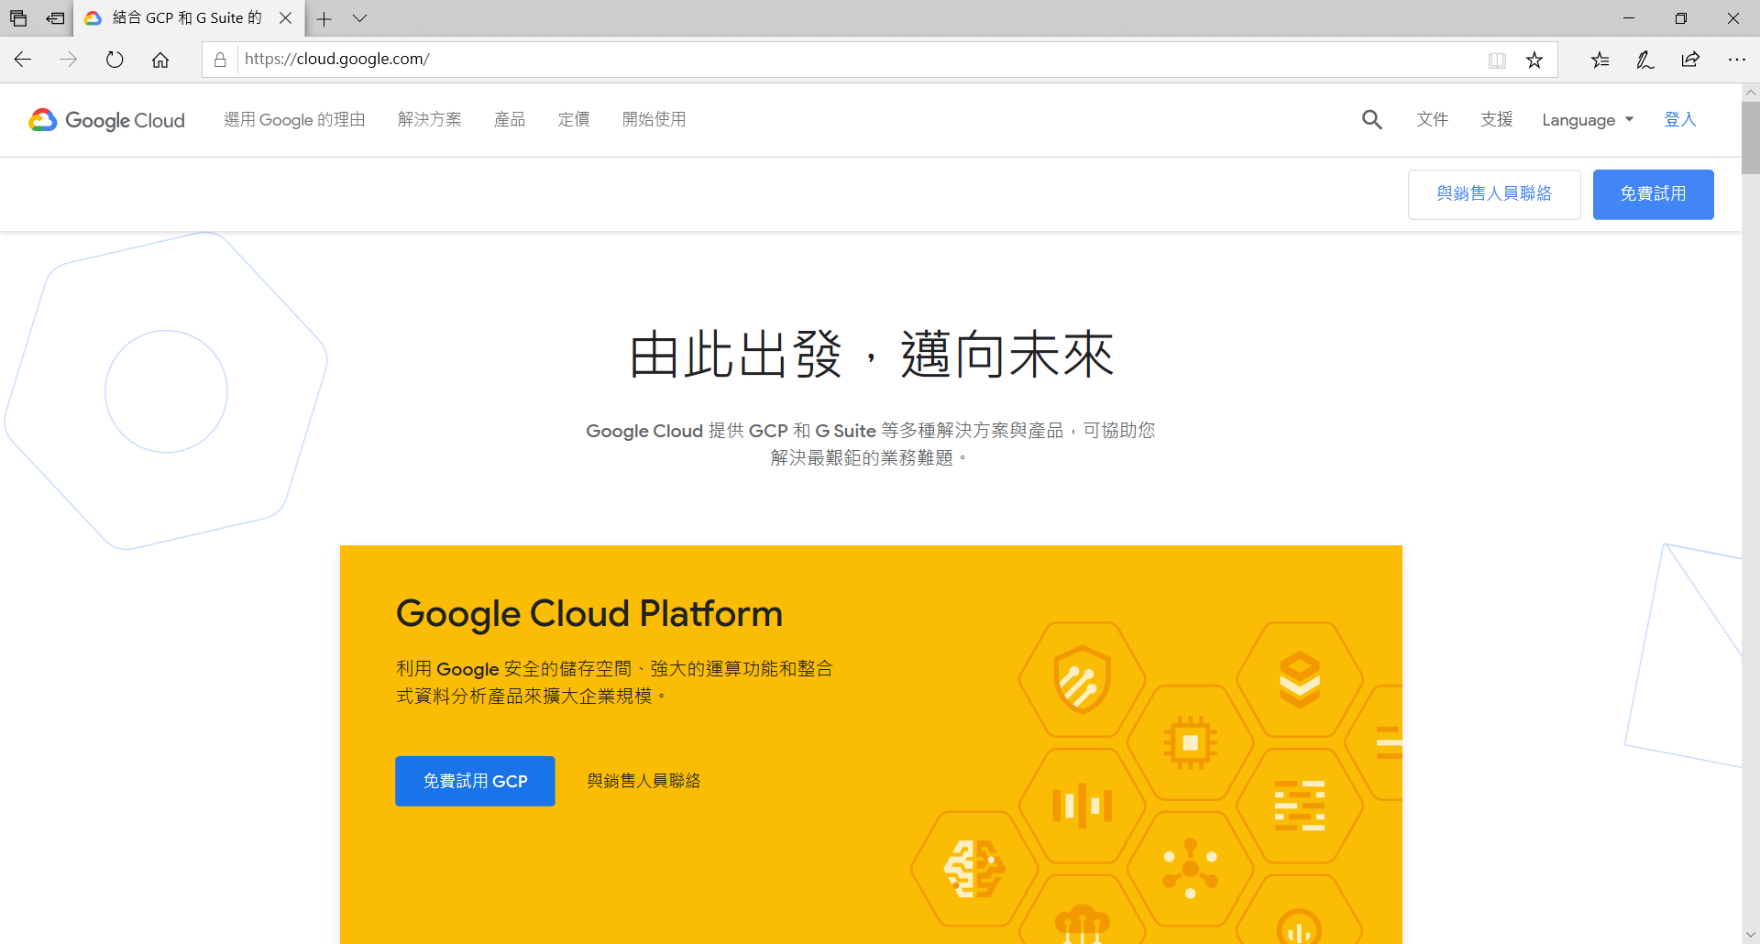
3. Create Google API project (1/2)
Browse to Google Cloud Platform and login

Slide 9

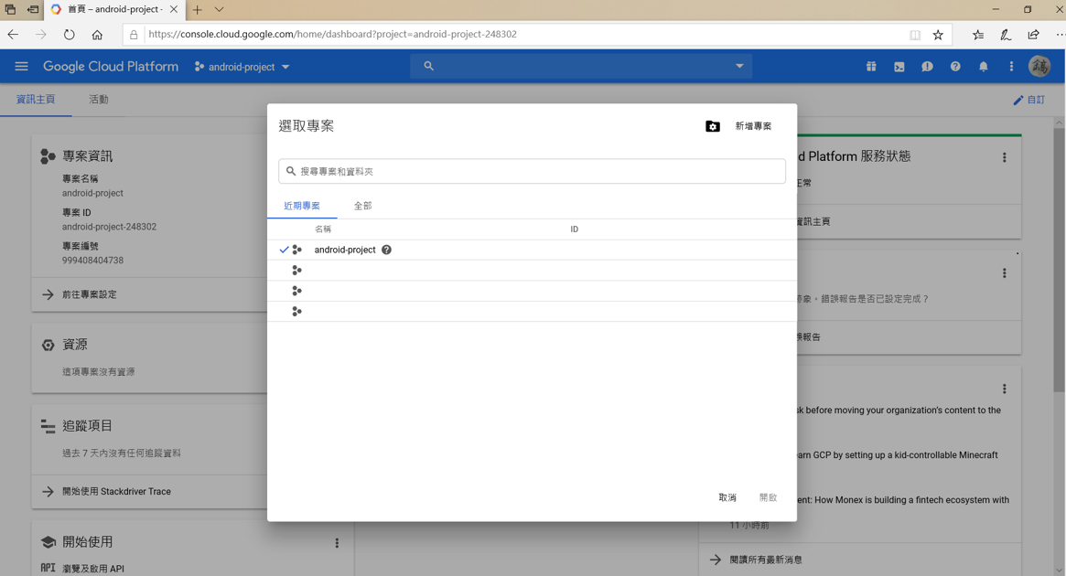
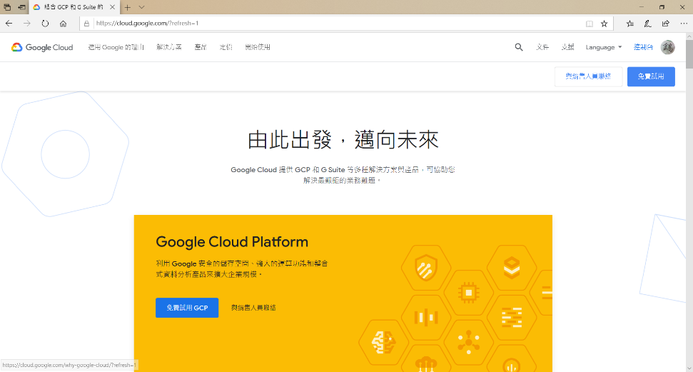
3. Create Google API project (2/2)
1. Login
3. Create project
2. Navigate to dashborad

Slide 10
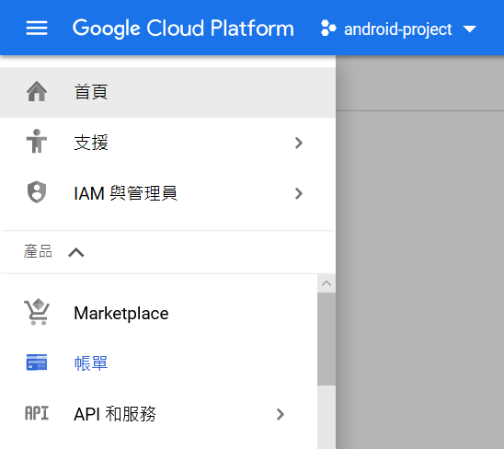
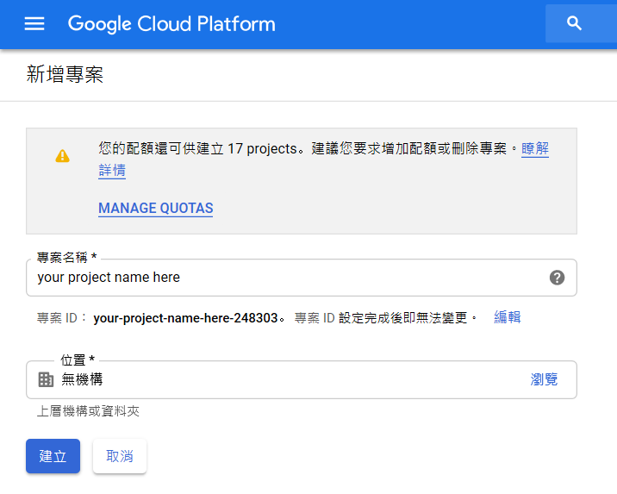
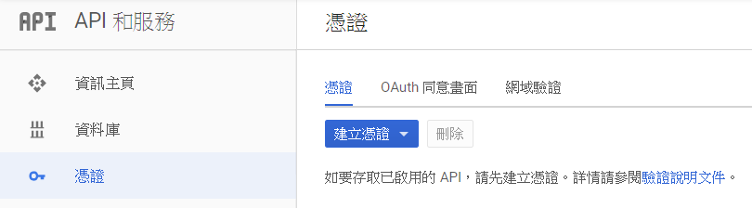
4. Add certification

Slide 11
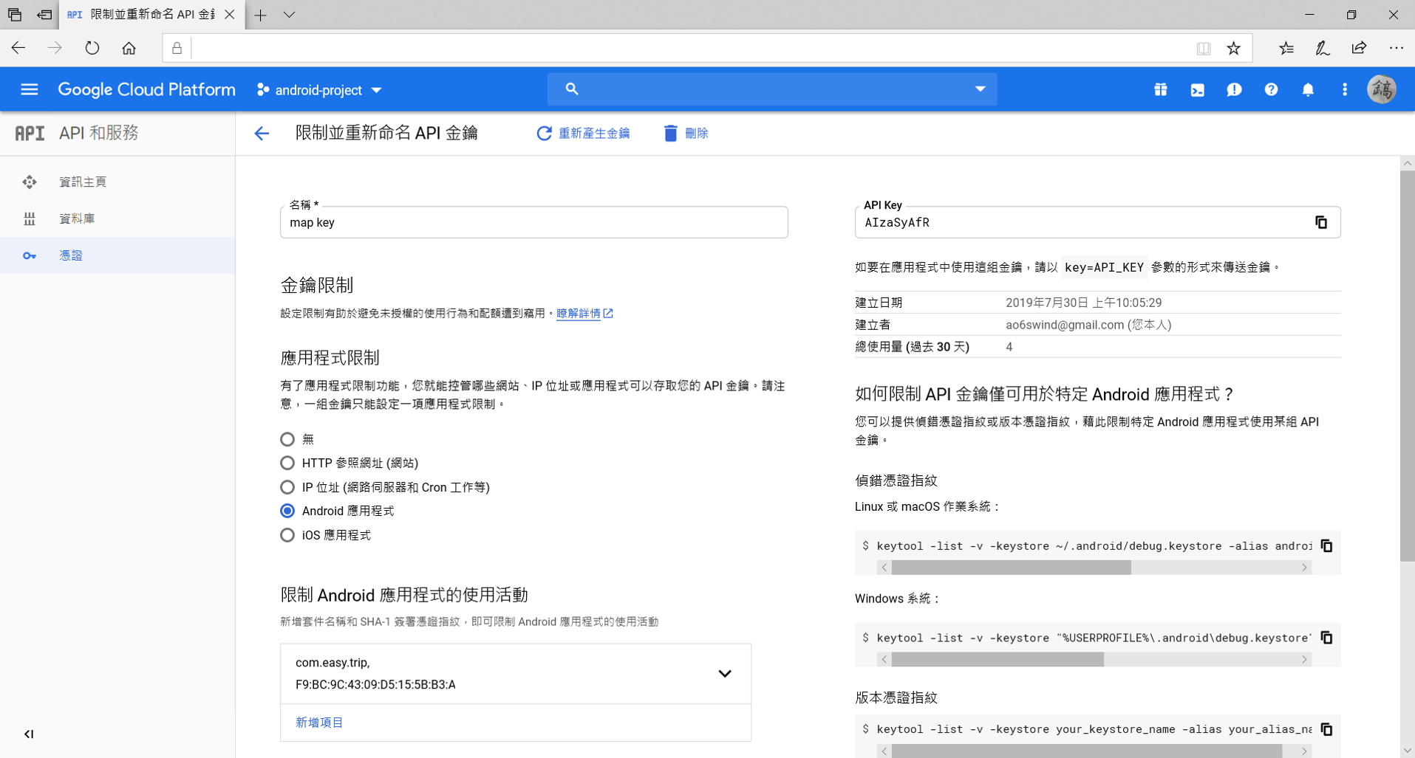
5. Get API key

Slide 12
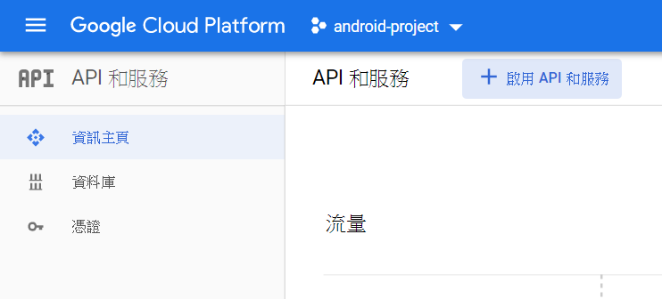
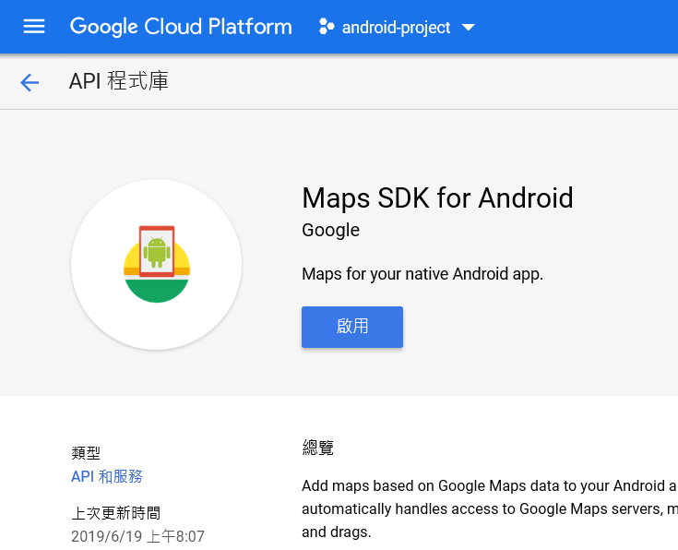
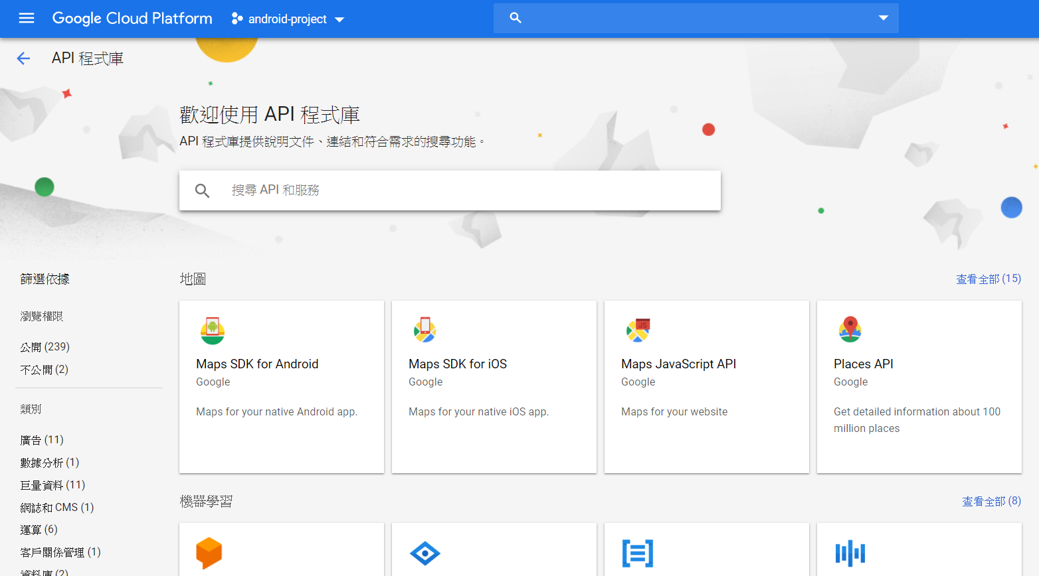
6. Enable Maps SDK for Android

Slide 13
Map UI
GoogleMap.uisettings.***

Slide 14
Gestures
Attribute
isTiltGesturesEnabled = boolean
isZoomGesturesEnabled = boolean
isRotateGesturesEnabled = boolean
isScrollGesturesEnabled = boolean
isScrollGesturesEnableedDuringRotateOrZoom = boolean
Method
setAllGesturesEnabled(boolean)
Notes:
isTiltGesturesEnabled: 是否允許手勢傾斜地圖
isZoomGesturesEnabled: 是否允許縮放地圖
isRotateGesturesEnabled: 是否允許旋轉地圖
isScrollGesturesEnabled: 是否允許拖曳地圖
isScrollGesturesEnableedDuringRotateOrZoom: 是否允許在旋轉或縮放時拖曳地圖
setAllGesturesEnabled() 如果要全開全關, 可以用這個方法

Slide 15
Marker

Slide 16

private fun addMarkerOnMap(bookmark: Bookmark) { val position = LatLng(bookmark.latitude, bookmark.longitude) val marker = map.addMarker(MarkerOptions() .position(position) .title(bookmark.name) .snippet(bookmark.comment) ) marker.tag = bookmark }
Notes:
Snippet: 片段

Slide 17
Get POI Information
POI = point of interest

Slide 18
Get POI Basic Information
// 當地圖上POI被點取時，取得POI的基本資訊 map.setOnPoiClickListener { it:PointOfInterest -> //it.placeId //it.name //it.latLng
}
com.easy.trip.activities.MapActivity

Slide 19
// 當地圖上POI被點取時，取得POI的基本資訊 map.setOnPoiClickListener { it:PointOfInterest -> val bookmark = bookmarkVM.findBookmarkByPlace(it.placeId) // 如果資料庫中有紀錄，則擷取資料庫的資料 if(bookmark != null) { val image = ImageUtils.loadBitmapFromFile(applicationContext, "${bookmark.placeId}.png") openForm(bookmark, image!!,false) } // 如果沒有，就向Google Place API擷取資料（要注意網路是否有通） else { // 取得Place的詳細資料 val request = FetchPlaceRequest.builder(it.placeId, capturePlaceFields).build() placesClient .fetchPlace(request) .addOnSuccessListener { placeResponse -> val place = placeResponse.place if(!place.photoMetadatas.isNullOrEmpty()) { place.photoMetadatas!![0]?.apply { // 取得Place的照片 val requestPhoto = FetchPhotoRequest.builder(this)
.setMaxHeight(270)
.setMaxWidth(480)
.build() placesClient.fetchPhoto(requestPhoto).addOnSuccessListener { photoResponse -> val bookmark = Bookmark( id = 0, placeId = place.id, name = place.name, address = place.address, phone = place.phoneNumber, latitude = place.latLng!!.latitude, longitude = place.latLng!!.longitude, comment = "" ) openForm(bookmark, photoResponse.bitmap, true) }.addOnFailureListener { e -> Log.e("com.easy.trip.activities.MapsActivity", "placesClient.fetchPhoto.failed: ${e.message}") } } } } .addOnFailureListener { e -> Log.e("com.easy.trip.activities.MapsActivity", "placesClient.fetchPlace.failed: ${e.message}") } } }
Get More Information
If has record, get data from database
Otherwise, get data from Place API
Request information of place
Request photo
com.easy.trip.activities.MapActivity

Slide 20
1. Get data from database
val bookmark = bookmarkVM.findBookmarkByPlace(it.placeId) // 如果資料庫中有紀錄，則擷取資料庫的資料 if(bookmark != null) { val image = ImageUtils.loadBitmapFromFile(applicationContext, "${bookmark.placeId}.png") openForm(bookmark, image!!, false) }
private fun openForm(bookmark: Bookmark, image: Bitmap, isCreateMode: Boolean) { val intent = Intent(this, FormActivity::class.java) val bundle = Bundle() /* 以下省略 */
startActivity(intent) }
com.easy.trip.activities.MapActivity
Notes:
打開表單的時候要傳入Bookmark、照片、新增或修改模式

Slide 21
2-1. Request information of place
private lateinit var placesClient: PlacesClient private val capturePlaceFields = asList( Place.Field.ID, Place.Field.NAME, Place.Field.ADDRESS, // 以下省略 )
val request = FetchPlaceRequest.builder(it.placeId, capturePlaceFields).build() placesClient .fetchPlace(request) .addOnSuccessListener { placeResponse -> val place = placeResponse.place
// 以下省略 } .addOnFailureListener { e -> Log.e("com.easy.trip.activities.MapsActivity", "placesClient.fetchPlace.failed: ${e.message}") }
com.easy.trip.activities.MapActivity

Slide 22
2-2. Request photo
val place = placeResponse.place if(!place.photoMetadatas.isNullOrEmpty()) { place.photoMetadatas!![0]?.apply { // 取得Place的照片 val requestPhoto = FetchPhotoRequest.builder(this).setMaxHeight(270).setMaxWidth(480).build() placesClient.fetchPhoto(requestPhoto).addOnSuccessListener { photoResponse -> val bookmark = Bookmark( id = 0, placeId = place.id,
comment = ""
// 以下省略 ) openForm(bookmark, photoResponse.bitmap, true) }.addOnFailureListener { e -> Log.e("com.easy.trip.activities.MapsActivity", "placesClient.fetchPhoto.failed: ${e.message}") } } }
com.easy.trip.activities.MapActivity

Slide 23
Save data

Slide 24
Layout
<?xml versio="1.0" encoding="utf-8"?> <ScrollView> <androidx.constraintlayout.widget.ConstraintLayout> <ImageView android:id="@+id/imgPreview"/> <View android:id="@+id/divider"/> <com.google.android.material.textfield.TextInputLayout> <com.google.android.material.textfield.TextInputEditText/> </com.google.android.material.textfield.TextInputLayout> <com.google.android.material.textfield.TextInputLayout> <com.google.android.material.textfield.TextInputEditText/> </com.google.android.material.textfield.TextInputLayout> <com.google.android.material.textfield.TextInputLayout> <com.google.android.material.textfield.TextInputEditText/> </com.google.android.material.textfield.TextInputLayout> <com.google.android.material.textfield.TextInputLayout> <com.google.android.material.textfield.TextInputEditText/> </com.google.android.material.textfield.TextInputLayout> <Button android:id="@+id/btnSave"/> <Button android:id="@+id/btnDelete"/> </androidx.constraintlayout.widget.ConstraintLayout> </ScrollView>
Notes:
重點要包一個ScrollView進來，否則一旦圖片太大或comment寫太多，表單會沒辦法往下拉

Slide 25
// 把MapActivity拋過來的資料擷取出來 val bundle = intent.extras val bookmark = bundle!!.getParcelable<Bookmark>("bookmark") val byteArray = bundle!!.getByteArray("image") val isCreateMode = bundle!!.getBoolean("isCreateMode") // 把ByteArray轉成Bitmap val bitmap = BitmapFactory.decodeByteArray(byteArray, 0, byteArray!!.size)
// 當Save按鈕被點擊時 btnSave.setOnClickListener { when(isCreateMode){ true -> { ImageUtils.saveBitmapToFile(applicationContext, bitmap,"${bookmark.placeId}.png") bookmarkVM.addBookmark(bookmark!!, txtComment.text.toString()) Toast.makeText(this, "create success", Toast.LENGTH_LONG).show() } false -> { bookmarkVM.editBookmark(bookmark!!) Toast.makeText(this, "update success", Toast.LENGTH_LONG).show() } } finish() }
com.easy.trip.utilities.ImageUtils
Notes:
建立一個Utility，圖片的save & load
在saveBitmapToFile方法中，
變數inputStream用來存放Bitmap壓縮轉換為png時的資料，並轉為Byte陣列
變數outputStream用來撰寫實體檔案至App中

Slide 26
object ImageUtils { fun saveBitmapToFile(context: Context, bitmap: Bitmap, filename: String) { val inputStream = ByteArrayOutputStream() bitmap.compress(Bitmap.CompressFormat.PNG, 100, inputStream) val bytes = inputStream.toByteArray() val outputStream: FileOutputStream try { outputStream = context.openFileOutput(filename, Context.MODE_PRIVATE) outputStream.write(bytes) outputStream.close() } catch (e: Exception) { Log.e("com.easy.trip.utilities.ImageUtils", "save image failed: ${e.message}") } } fun loadBitmapFromFile(context: Context, filename: String): Bitmap? { val filePath = File(context.filesDir, filename).absolutePath return BitmapFactory.decodeFile(filePath) } fun removeFile(context: Context, filename: String): Boolean { when(File(context.filesDir, filename).exists()) { true -> return File(context.filesDir, filename).delete() false -> return false } } }
com.easy.trip.utilities.ImageUtils
Notes:
建立一個Utility，圖片的save & load
在saveBitmapToFile方法中，
變數inputStream用來存放Bitmap壓縮轉換為png時的資料，並轉為Byte陣列
變數outputStream用來撰寫實體檔案至App中

Slide 27
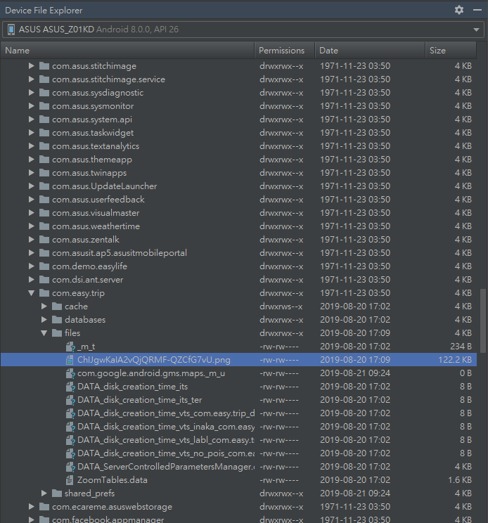
View file in APP
→ DeviceFileExploer
→ data
→ data
→ PACKAGE_NAME
→ files

Slide 28
InfoWindow

Slide 29
class InfoWindowAdapter(private val context: Activity) : GoogleMap.InfoWindowAdapter { private val contents: View init { contents = context.layoutInflater.inflate(R.layout.info_window_layout, null) } override fun getInfoContents(marker: Marker): View? { val bookmark = marker.tag as Bookmark val title = contents.findViewById<TextView>(R.id.txtPositionTitle) val snippet = contents.findViewById<TextView>(R.id.txtPositionSnippet) val image = contents.findViewById<ImageView>(R.id.imageView) title.text = bookmark.name snippet.text = bookmark.comment image.setImageBitmap(ImageUtils.loadBitmapFromFile(context, "${bookmark.placeId}.png")) return contents } override fun getInfoWindow(marker: Marker): View? { return null } }
com.easy.trip.adapters.InfoWindowAdapter
Notes:
建立adapter
如果只用marker的部分屬性帶資料進來會不夠用，這時候可以善加利用tag屬性

Slide 30
class MapsActivity : AppCompatActivity(), OnMapReadyCallback {
override fun onMapReady(googleMap: GoogleMap) { // 建立地圖 map = googleMap // 修改InfoWindow排版 & InfoWindow點擊時的動作 map.setInfoWindowAdapter(InfoWindowAdapter(this)) map.setOnInfoWindowClickListener { it: Marker -> val bookmark = it.tag as Bookmark val image = ImageUtils.loadBitmapFromFile(applicationContext, "${bookmark.placeId}.png") openForm(bookmark, image!!,false) } } }
com.easy.trip.activities.MapActivity
Notes:
在map中選擇要將地圖中的info window用哪一個adapter將UI串起來

Slide 31
Others

Slide 32
@Database(entities = [Bookmark::class], version = 2) abstract class EasyTripDatabase: RoomDatabase() { abstract fun bookmarkDao(): BookmarkDAO companion object { private var instance: EasyTripDatabase? = null fun getInstance(context: Context): EasyTripDatabase{ if(instance == null) { instance = Room. databaseBuilder(context.applicationContext, EasyTripDatabase::class.java, "EasyTripDatabase") .addMigrations(MIGRATION_1_2) .build() } return instance as EasyTripDatabase } // 如果APP已經上架，且有需要更改資料庫欄位時，必須作遷移的動作 val MIGRATION_1_2: Migration = object : Migration(1, 2) { override fun migrate(database: SupportSQLiteDatabase) { database.execSQL("ALTER TABLE Bookmarks ADD COLUMN comment TEXT") } } } }

Slide 33
@Entity( tableName = "Bookmarks", indices = [ Index(name="idx_place_id", value = ["placeId"], unique = true), Index(name="idx_location", value = ["latitude", "longitude"]) ] ) data class Bookmark( @PrimaryKey(autoGenerate = true) var id: Long, var placeId: String?, var name: String?, var address: String?, var phone: String?, var latitude: Double, var longitude: Double, var comment: String? ): Parcelable{
// 以下省略
}
Notes:
Table名稱預設是model類別名稱，如果想改名可以用tableName屬性
Index也可以下（唯一值、複合等）
可以實作Parccelable，比較方便在activity之間傳遞資料

